Slide 1
Leading Great Meetings

Slide 2
Before The Meeting
Identify your objective. Establish the purpose, goals, and desired outcomes of the meeting, including any questions or requests that need to be addressed.
Acknowledge participants and keep them involved with different points of view and experiences with the data, the project, or the business.
Organize the data to be presented. You might need to turn raw data into accessible formats or create data visualizations.
Prepare and distribute an agenda. We will go over this next.

Slide 3
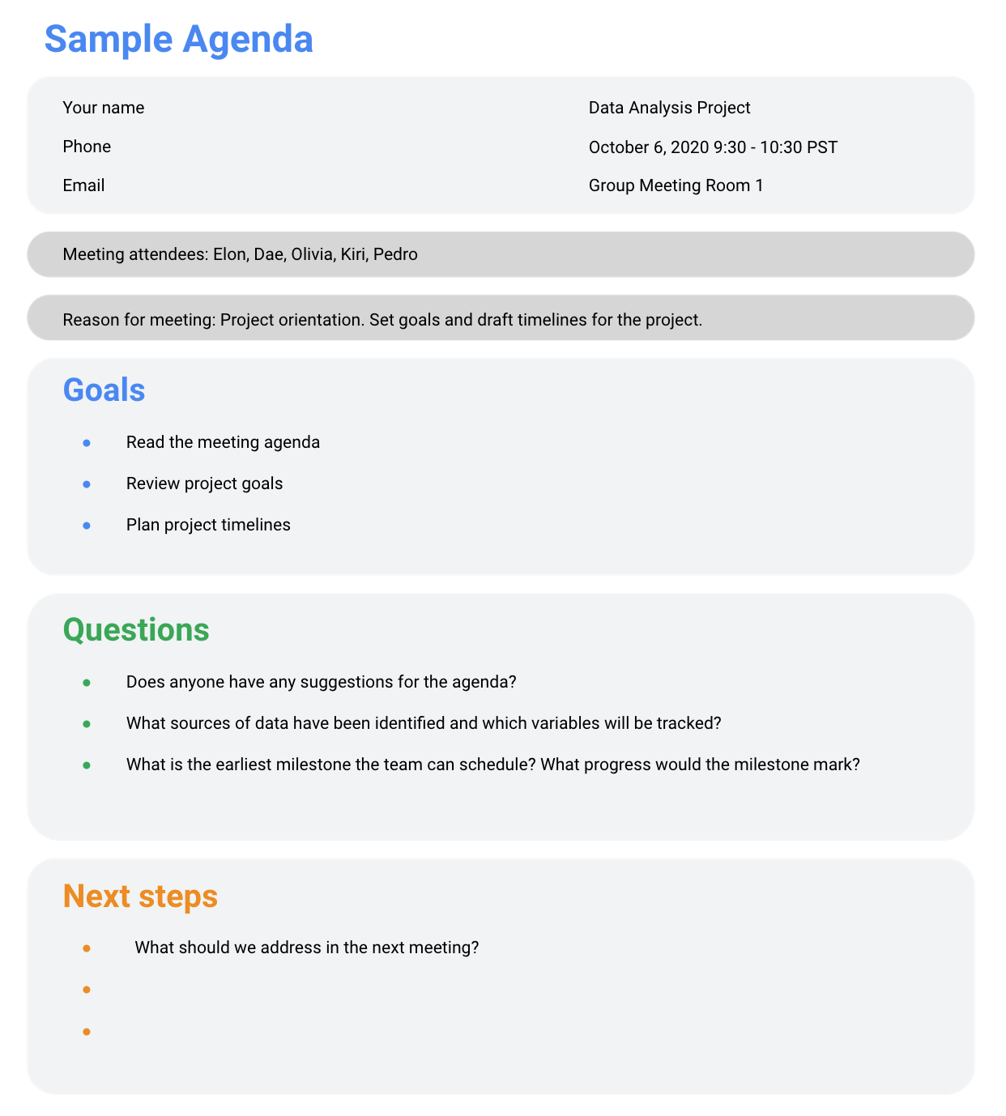
Creating a Agenda
Goals
Questions
Next Steps

Slide 4
During The Meeting
Make introductions (if necessary) and review key messages
Present the data
Discuss observations, interpretations, and implications of the data
Take notes during the meeting
Determine and summarize next steps for the group

Slide 5
After The Meeting
Distribute a brief summary of the meeting
Distribute any notes or data
Confirm next steps and timeline for additional actions
Ask for feedback (this is an effective way to figure out if you missed anything in your recap)

